Slide 1
The Basics of Capital Budgeting
Characteristic of Capital Budgeting Decision;
Capital budgeting decision process;
Types of capital budgeting projects;
Capital budgeting decision techniques:
Payback Period,
Discounted Payback Period,
Net Present Value,
Profitability Index,
Internal Rate of Return,
Modified Internal Rate of Return;
Merits and Limitations of each Capital Budgeting Decision Technique.

Slide 2
Concept of Capital Budgeting
Capital : Long term assets used in production
Budget: plan which details projected inflows and outfows during some future period
Capital Budget: Appropriation of resources for acquiring fixed assets
Budgeting: implies process
Capital Budgeting: process of acquiring the fixed assets or process of investment in capital projects.
Analysis of potential additions to fixed assets.
Long-term decisions; involve large expenditures
Examples: investment in property, plant and equipment, research and development projects, larger advertising campaigns, or any project that require a capital expenditure and generates future cash flow

Slide 3
Characteristics of Capital Budgeting
Required Huge Funds
High Degree of Risk
Long Term Effect
Irreversibility
Impact Cost Structure
Long term Commitment of Funds
Complexity

Slide 4
Significance of Capital Budgeting
Irreversible
Growth
Large Amount of Funds
Risk
Complex
National Importance

Slide 5
Capital Budgeting Decision Process
Generation of Investment Proposal
Review and Analysis
In light of firm’s overall objectives and plans
To evaluate economic validity
Decision Making
Implementation
Follow Up
OR
Generation of Investment Proposal
Estimation of cash flow for the proposal
Evaluation of the proposal
Approval of Proposal

Slide 6
Classification of Capital Project
Independent Project
Dependent Project
Mutually Exclusive Project
Replacement Project
Expansion Project
Diversification Project

Slide 7
Definitions
Independent versus mutually exclusive projects.
Independent projects – if the cash flows of one are unaffected by the acceptance of the other.
Mutually exclusive projects – if the cash flows of one can be adversely impacted by the acceptance of the other.
Normal versus non-normal cash flow stream.
Normal cash flow stream – Cost (negative CF) followed by a series of positive cash inflows. One change of signs.
Non-normal cash flow stream – Two or more changes of signs. Most common: Cost (negative CF), then string of positive CFs, then cost to close project. Nuclear power plant, strip mine, etc.

Slide 8
Identifying Relevant Cash Flows
Cash flow Versus Accounting Income
The Cash Flow Effect of Asset Purchases and Depreciation
Changes in Net Operating Working Capital.
Interest Charges Are Not Included in Project Cash Flows
Include Only Incremental Cost
= cash flows with the project − cash flows without the project
Disregarded Sunk Cost
Include Opportunity Cost
Always Adjust for Taxes
Ignore Financing Cost

Slide 9
Capital Budgeting Decision Techniques
Two Broad Categories:
Non Discounted Cash flow Method
Pay Back Period (Cash Pay Back Period)
Accounting Rate of Return (ARR)
B. Discounted Cash flow Method
Discounted Pay Back Period
Net Present Value
Profitability Index
Internal Rate of Return (IRR)
Modified Internal Rate of Return (MIRR)

Slide 10
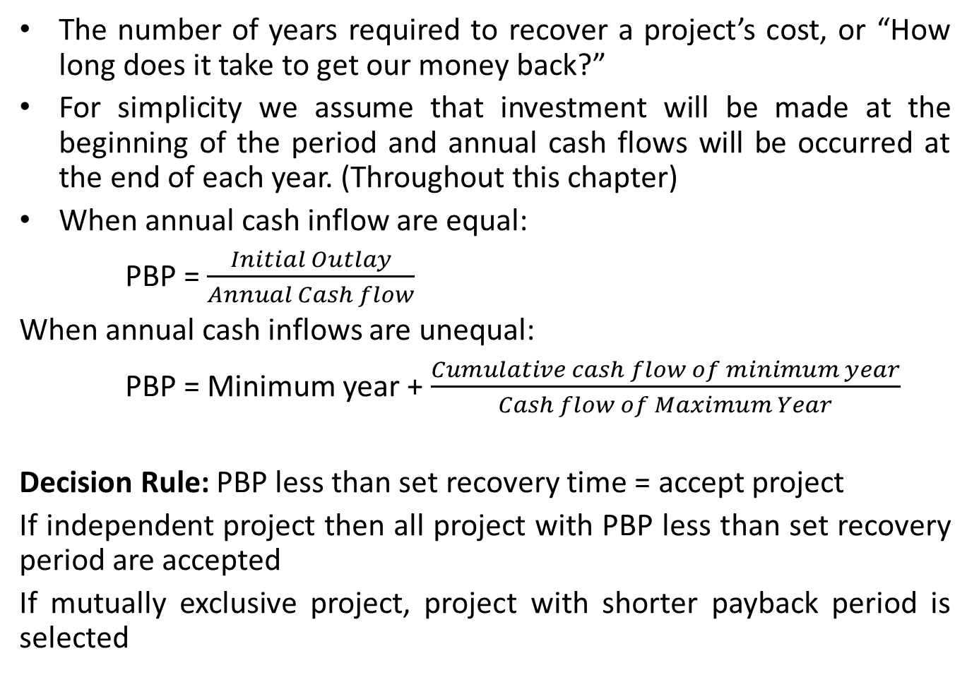
Pay Back Period (PBP)
The number of years required to recover a project’s cost, or “How long does it take to get our money back?”
For simplicity we assume that investment will be made at the beginning of the period and annual cash flows will be occurred at the end of each year. (Throughout this chapter)
When annual cash inflow are equal:
PBP = $\frac{Initial Outlay}{Annual Cash flow}$
When annual cash inflows are unequal:
PBP = Minimum year + $\frac{Cumulative cash flow of minimum year}{Cash flow of Maximum Year}$
Decision Rule: PBP less than set recovery time = accept project
If independent project then all project with PBP less than set recovery period are accepted
If mutually exclusive project, project with shorter payback period is selected

Slide 11
Pay Back Period (PBP)
Example 1: Annual after tax cash flows of Project A and Project B are given below:
Calculate payback period for both Project A and Project B and decide which project or projects should be accepted if these projects are independent and required payback period is 4 years. What will be your decision if these projects are mutually exclusive?
Year | 0 | 1 | 2 | 3 | 4 | 5
CF of Project (A) (Rs) | (10,000) | 3,000 | 3,000 | 3,000 | 3,000 | 3,000
CF of Project (B) (Rs) | (10,000) | 1,000 | 2,000 | 3,000 | 5,000 | 6,000

Slide 12
Merits and Limitations of Pay Back Period
Merits:
Simple and Easy to Understand in concept as well as its application
Adopted by small firms
Gives an indication of liquidity
Deals with the risk (shorter PBP = less risky)
Limitations:
Ignores the cash flows of projects after recovery of original investment
Ignores the time value of Money
Difficulties on determining the maximum acceptable payback period
PBP is not consistent with objective of maximizing the market value of the firm’s share

Slide 13
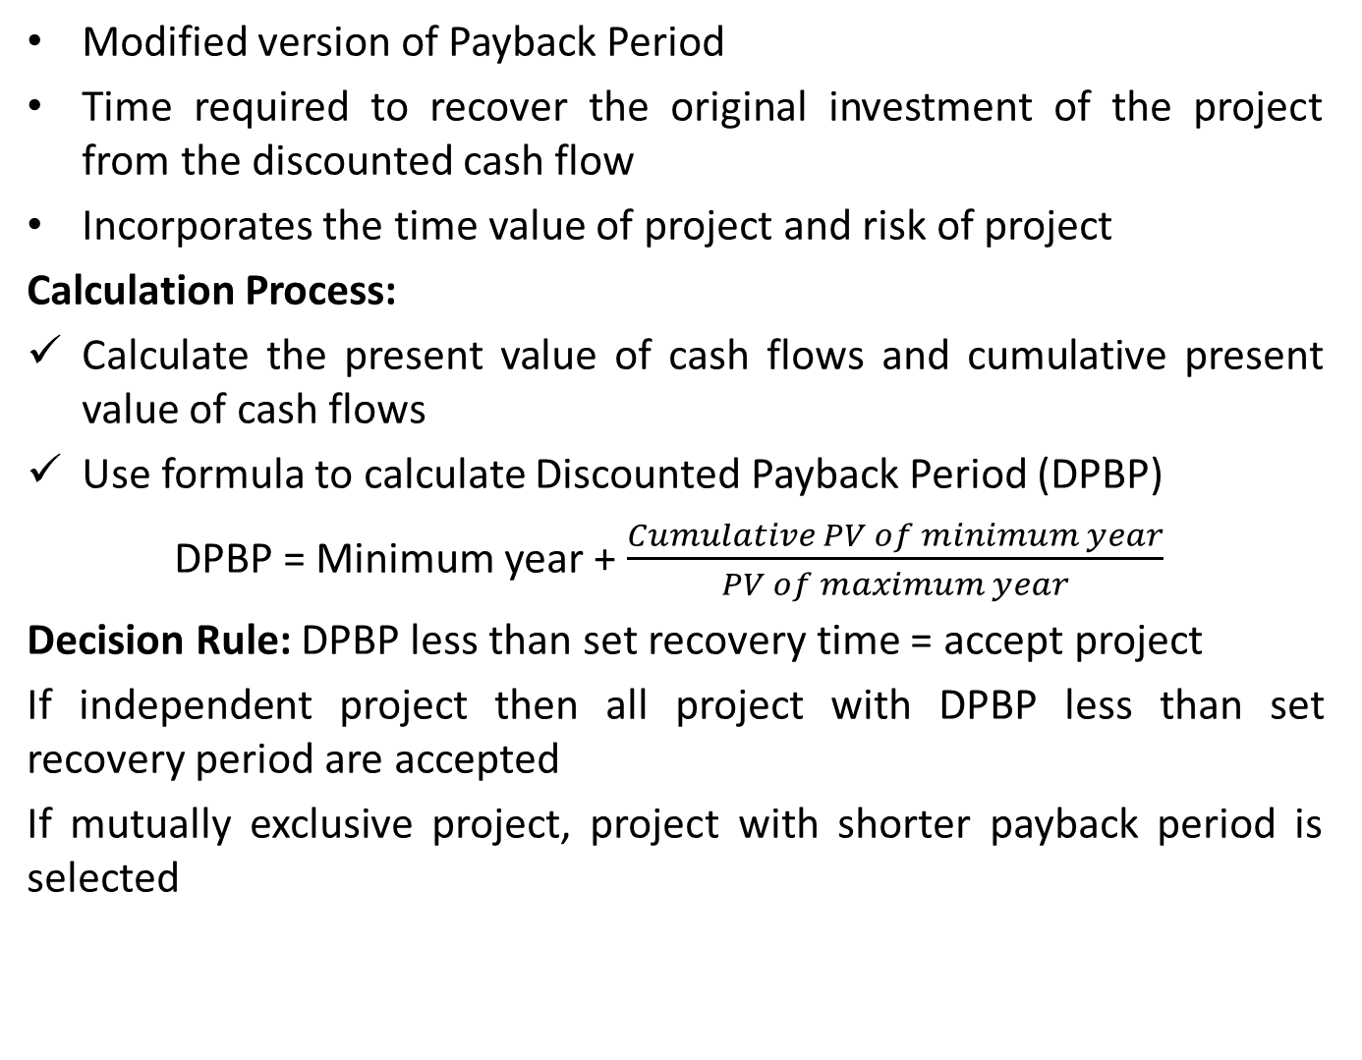
Discounted Payback Period (DPBP)
Modified version of Payback Period
Time required to recover the original investment of the project from the discounted cash flow
Incorporates the time value of project and risk of project
Calculation Process:
Calculate the present value of cash flows and cumulative present value of cash flows
Use formula to calculate Discounted Payback Period (DPBP)
DPBP = Minimum year + $\frac{Cumulative PV of minimum year}{PV of maximum year}$
Decision Rule: DPBP less than set recovery time = accept project
If independent project then all project with DPBP less than set recovery period are accepted
If mutually exclusive project, project with shorter payback period is selected

Slide 14
Discounted Payback Period (DPBP)
Example 2. You are a financial analyst for Mechi Tea Company. The director of capital budgeting has asked you to analyse two proposed capital investments: Project X and Project Y. Each project had a cost of Rs. 100,000 and the cost of capital for each project is 10 percent. The expected net cash flows are as follows:
Calculate the discounted payback period of each period.
According to the discounted payback period criterion, which period or project should be accepted if the firm’s maximum acceptable discounted payback period is 3 years, and if projects are independent ? If they are mutually exclusive ?
Year | Project X (in Rs) | Project Y (in Rs)
0 | (100,000) | (100,000)
1 | 35,000 | 30,000
2 | 35,000 | 30,000
3 | 35,000 | 30,000
4 | 35,000 | 60,000

Slide 15
Merits and Limitations of DPBP
Merits
Consider time value of money
Simple and Easy to Understand
Gives indication of liquidity
Deals with risk
Limitations
Does not consider cash flow beyond the payback year
Difficult to determine maximum acceptable discounted payback period
Decision is not consistent with the wealth maximization goal
can get complex if there are multiple negative cash flows during an investment period

Slide 16
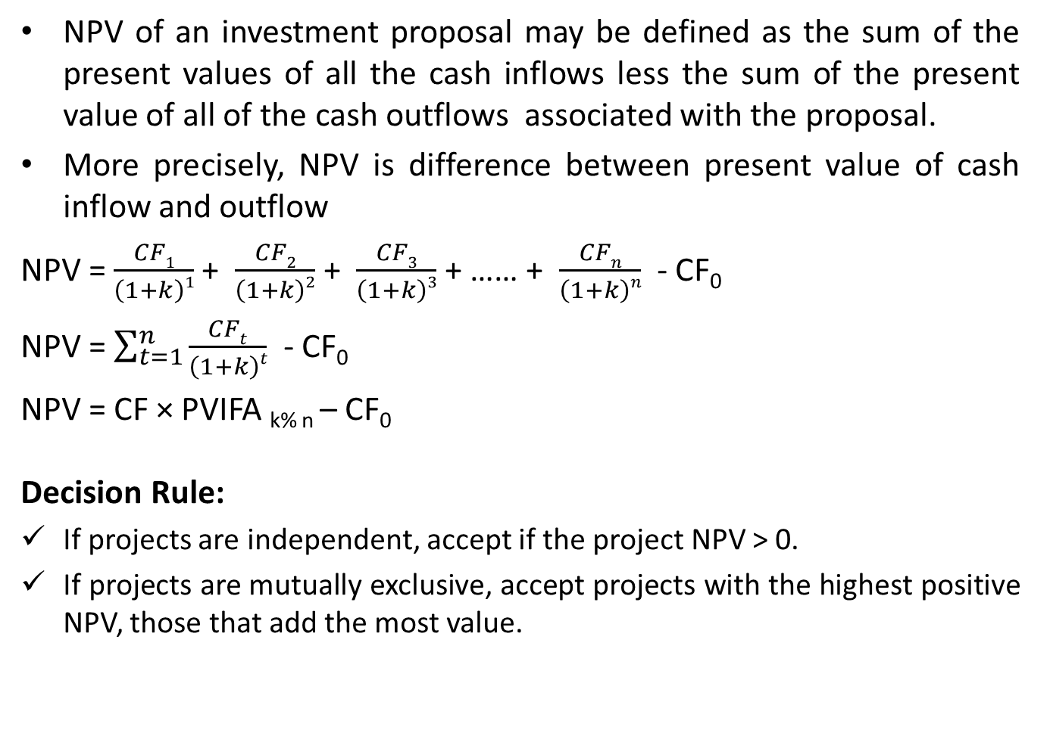
Net Present Value (NPV)
NPV of an investment proposal may be defined as the sum of the present values of all the cash inflows less the sum of the present value of all of the cash outflows associated with the proposal.
More precisely, NPV is difference between present value of cash inflow and outflow
NPV = $\frac{CF1}{\left(1+k\right)1}$ + $\frac{CF2}{\left(1+k\right)2}$ + $\frac{CF3}{\left(1+k\right)3}$ + …… + $\frac{CFn}{\left(1+k\right)n}$ - CF₀
NPV = $\sum_{t=1}^{n}{\frac{CFt}{\left(1+k\right)t}}$ - CF₀
NPV = CF × PVIFA _{k% n} – CF₀
Decision Rule:
If projects are independent, accept if the project NPV > 0.
If projects are mutually exclusive, accept projects with the highest positive NPV, those that add the most value.

Slide 17
Net Present Value (NPV)
Example 3: Following are the cash flows of equally risky project X and Project Y
Suppose you are the Project Manager and you have to recommend one of these projects for the approval of the Board of Directors. The required rate of return on these projects is 10 percent.
Calculate the net present value (NPV) of each project. Based on NPV which project would you recommend to the Board?
Year | Project X (in Rs) | Project Y (in Rs)
0 | (600,000) | (600,000)
1 | 150,000 | 170,000
2 | 150,000 | 100,000
3 | 150,000 | 80,000
4 | 150,000 | 70,000
5 | 150,000 | 100,000

Slide 18
Merits and Demerits of NPV
Merits
Considers all cash flows in the computation
NPV uses the time value of money
Provides answer in rupees term, which is easy to understand
Consistent with objectives of maximization of shareholders wealth
Based on estimated cash flow of project rather than on accounting income
Demerits
Difficult to forecast cash flow due to presence of uncertainty
Required predetermination of discount rate which is different to predetermine
Depending on the discount rates, the different rank may be assigned to the same independent project
Difficult to calculate when project have unequal lives and budget constraints

Slide 19
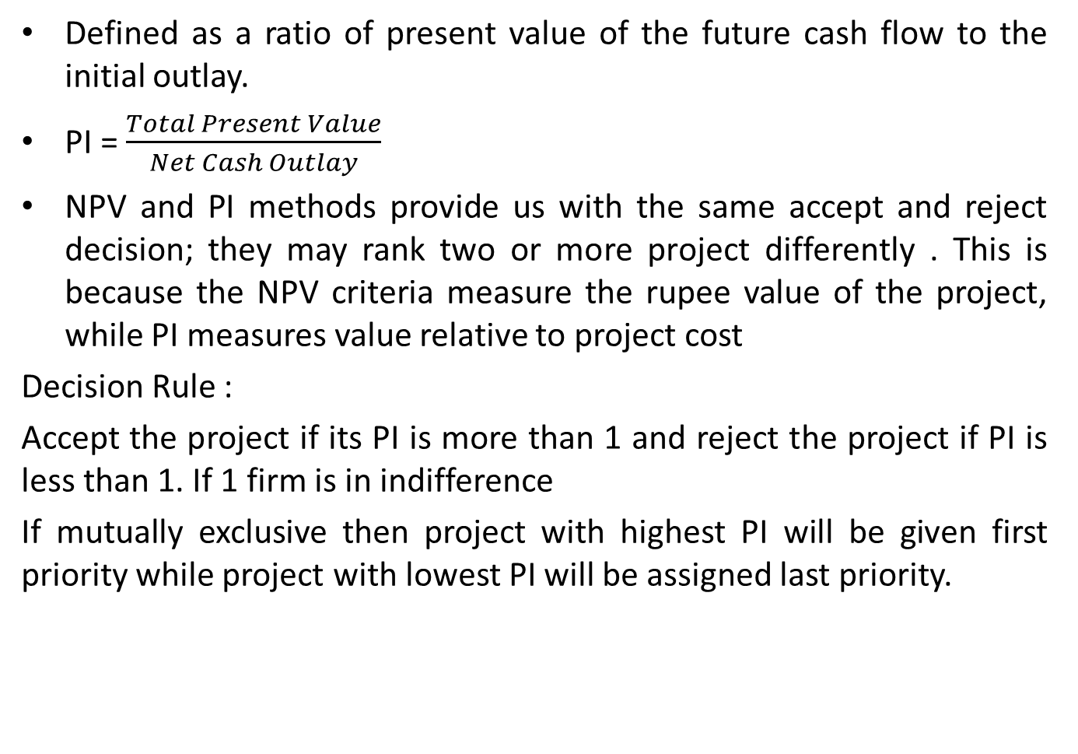
Profitability Index (PI)
Defined as a ratio of present value of the future cash flow to the initial outlay.
PI = $\frac{Total Present Value}{Net Cash Outlay}$
NPV and PI methods provide us with the same accept and reject decision; they may rank two or more project differently . This is because the NPV criteria measure the rupee value of the project, while PI measures value relative to project cost
Decision Rule :
Accept the project if its PI is more than 1 and reject the project if PI is less than 1. If 1 firm is in indifference
If mutually exclusive then project with highest PI will be given first priority while project with lowest PI will be assigned last priority.

Slide 20
Conflict between NPV and PI
If choice between mutually exclusive project have to be made on basis of following information:
Which project would you choose ?
Merits and Demerits of PI are similar to NPV technique. One additional merit is PI shows the relative profitability of the project.
Project | A | B
PV of Cash inflows | Rs. 200,000 | Rs. 100,000
Net cash Outlay | Rs. 100,000 | Rs. 40,000
NPV | + Rs 100,000 | + Rs 60,000
PI | 2 | 2.5

Slide 21
Profitability Index (PI)
Example 4: The West Computer Corporation is trying to choose between the following two mutually exclusive design project
If the required return is 10 percent and the company applies the profitability index decision rule, which project should firm accept ?
If the company applies the NPV decision rule, which project should it take ?
Explain why your answer in (a) and (b) are different
Year | Cash flow (A) | Cash flow (B)
0 | - Rs 53,000 | - Rs 16,000
1 | 27,000 | 9,100
2 | 27,000 | 9,100
3 | 27,000 | 9,100

Slide 22
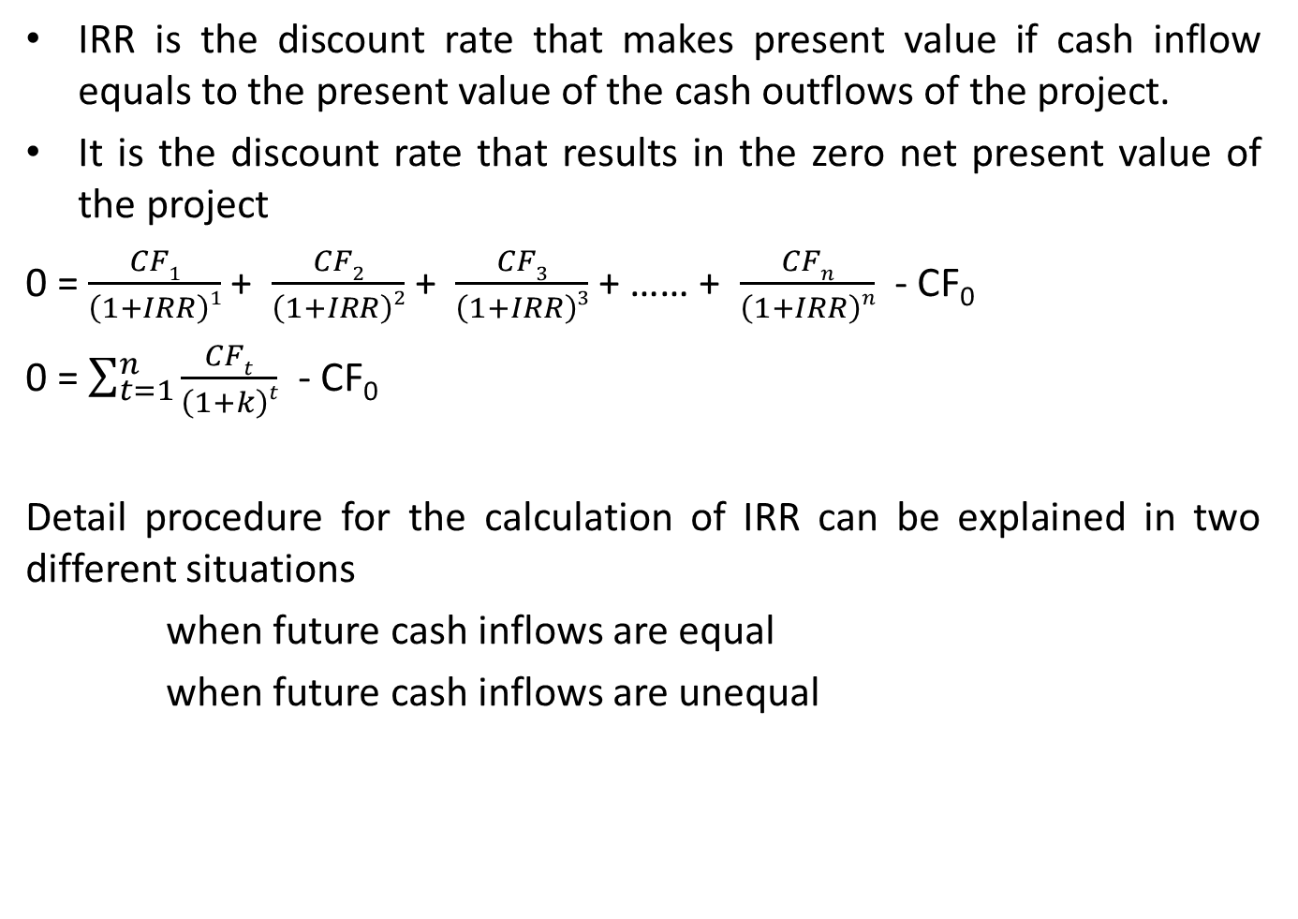
Internal Rate of Return (IRR)
IRR is the discount rate that makes present value if cash inflow equals to the present value of the cash outflows of the project.
It is the discount rate that results in the zero net present value of the project
0 = $\frac{CF1}{\left(1+IRR\right)1}$ + $\frac{CF2}{\left(1+IRR\right)2}$ + $\frac{CF3}{\left(1+IRR\right)3}$ + …… + $\frac{CFn}{\left(1+IRR\right)n}$ - CF₀
0 = $\sum_{t=1}^{n}{\frac{CFt}{\left(1+k\right)t}}$ - CF₀
Detail procedure for the calculation of IRR can be explained in two different situations
when future cash inflows are equal
when future cash inflows are unequal

Slide 23

Internal Rate of Return (IRR)
When Future Cash flows are equal:
Step 1: First we calculate payback period or factor
Step 2: Find discount rate for interpolation by looking at the PVIFA table for n^{th} year (project life)
Step 3: Calculate the actual IRR using the equation:
IRR = LR + $\frac{PVIFA LR − PBP or factor}{PVIFA LR −PVIFA HR}$ × (HR – LR )

Slide 24
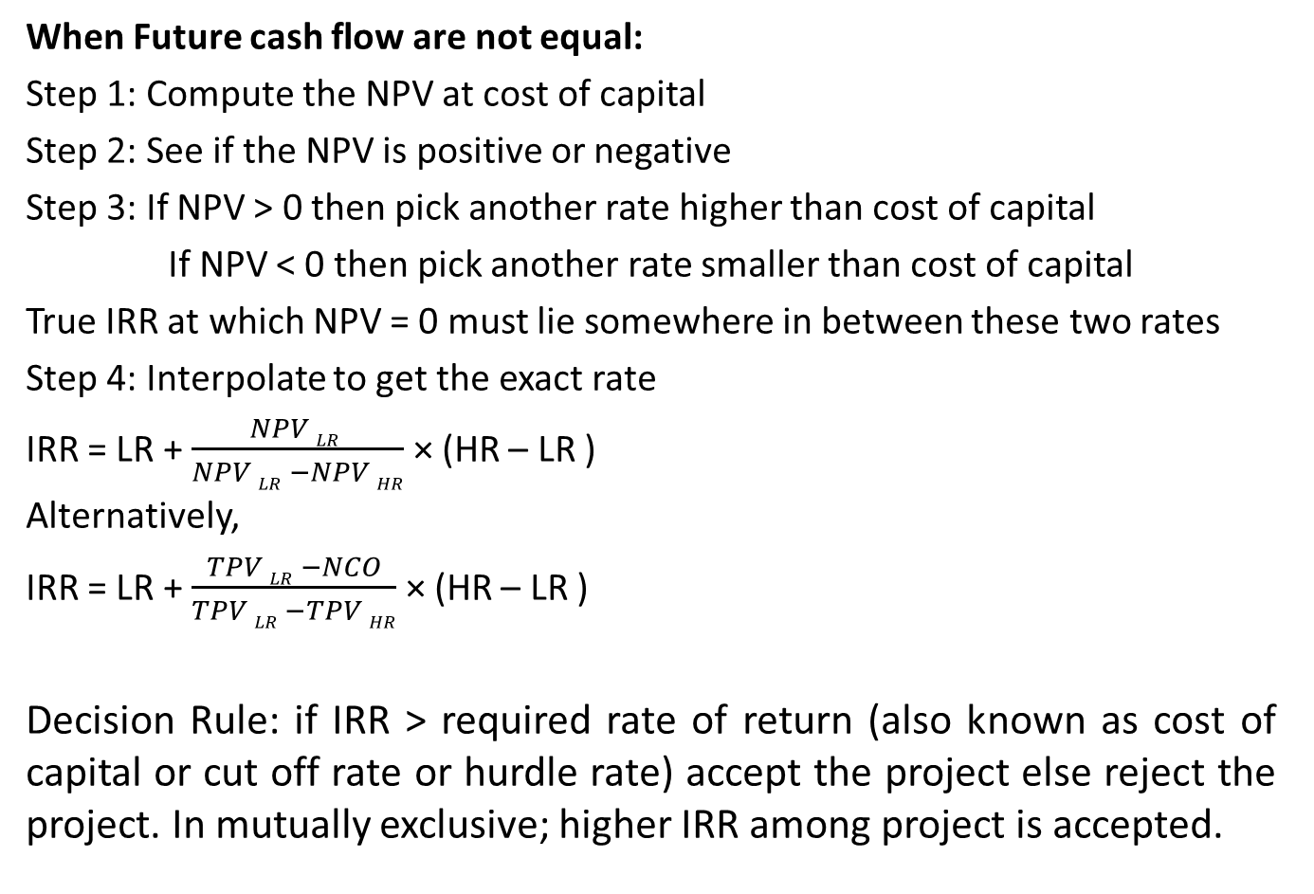
Internal Rate of Return (IRR)
When Future cash flow are not equal:
Step 1: Compute the NPV at cost of capital
Step 2: See if the NPV is positive or negative
Step 3: If NPV > 0 then pick another rate higher than cost of capital
If NPV < 0 then pick another rate smaller than cost of capital
True IRR at which NPV = 0 must lie somewhere in between these two rates
Step 4: Interpolate to get the exact rate
IRR = LR + $\frac{NPV LR }{NPV LR −NPV HR}$ × (HR – LR )
Alternatively,
IRR = LR + $\frac{TPV LR −NCO}{TPV LR −TPV HR}$ × (HR – LR )
Decision Rule: if IRR > required rate of return (also known as cost of capital or cut off rate or hurdle rate) accept the project else reject the project. In mutually exclusive; higher IRR among project is accepted.

Slide 25
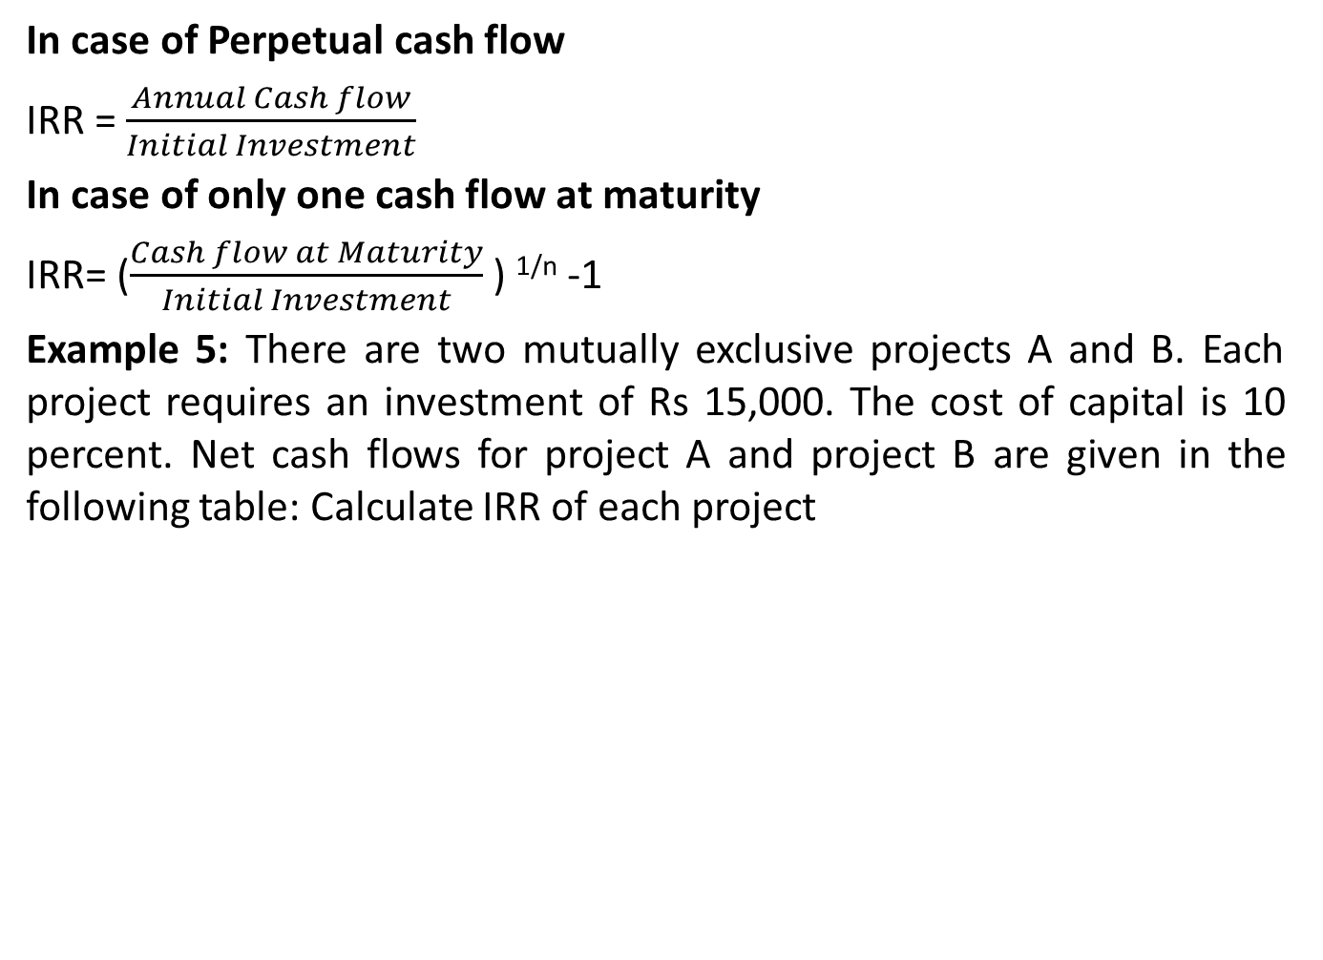
Internal Rate of Return (IRR)
In case of Perpetual cash flow
IRR = $\frac{Annual Cash flow}{Initial Investment}$
In case of only one cash flow at maturity
IRR= ($\frac{Cash flow at Maturity}{Initial Investment}$ ) ^{1/n} -1
Example 5: There are two mutually exclusive projects A and B. Each project requires an investment of Rs 15,000. The cost of capital is 10 percent. Net cash flows for project A and project B are given in the following table: Calculate IRR of each project
Year | Net Cash Flow
 | Project A (in Rs) | Project B (in Rs)
1 | 4,000 | 1,000
2 | 4,000 | 2,000
3 | 4,000 | 4,000
4 | 4,000 | 5,000
5 | 4,000 | 8,000

Slide 26
Internal Rate of Return (IRR)
Practice Question:
Calculate the internal rate of return (IRR) of the following investment:
An investment of Rs. 10,000 today will return Rs. 20,000 at the end of 10 years.
An investment of Rs. 10,000 will return Rs. 1,300 per year forever.

Slide 27
Merits and Demerits of IRR
Merits:
Takes into account the time value of money
Consistent with the value maximization decision criterion
Consider all cash flows
Easier to understand and communicate in terms of percent rather than rupee amount
Demerits:
Involves tedious and complicated trial and error procedure
Multiple IRR for a project with non normal cash flows
Assumption regarding future cash inflows of a proposal are reinvested at a rate equal to the IRR
Projects selected based on higher IRR may not be profitable

Slide 28
Comparing NPV and IRR
Both are the methods of discounted cash flows and both methods considers time value of money and give same accept-reject decision for independent projects.
Both methods considers all cash flows over the life of the project
Differences between them:
Basis for comparison | NPV | IRR
Meaning | TPV – Initial Cost | Rate at which NPV = 0
Expressed In | Absolute Term | Percentage Term
Represent | Surplus from project | Point of no profit no loss
Decision Making | Makes easy | Does not help
Reinvestment Rate | Cost of Capital | Internal Rate of Return
Non-normal cash flows | Single NPV | Multiple IRR
Addition | NPV can be additive | IRRs cannot be added
Ranking | Better Ranking | Not Better Ranking

Slide 29
Why conflicts between NPV and IRR Arises
Differing Size / Scale Projects
Differing Cash flows
Project Life: Projects have unequal useful lives
Multiple rate of returns

Slide 30
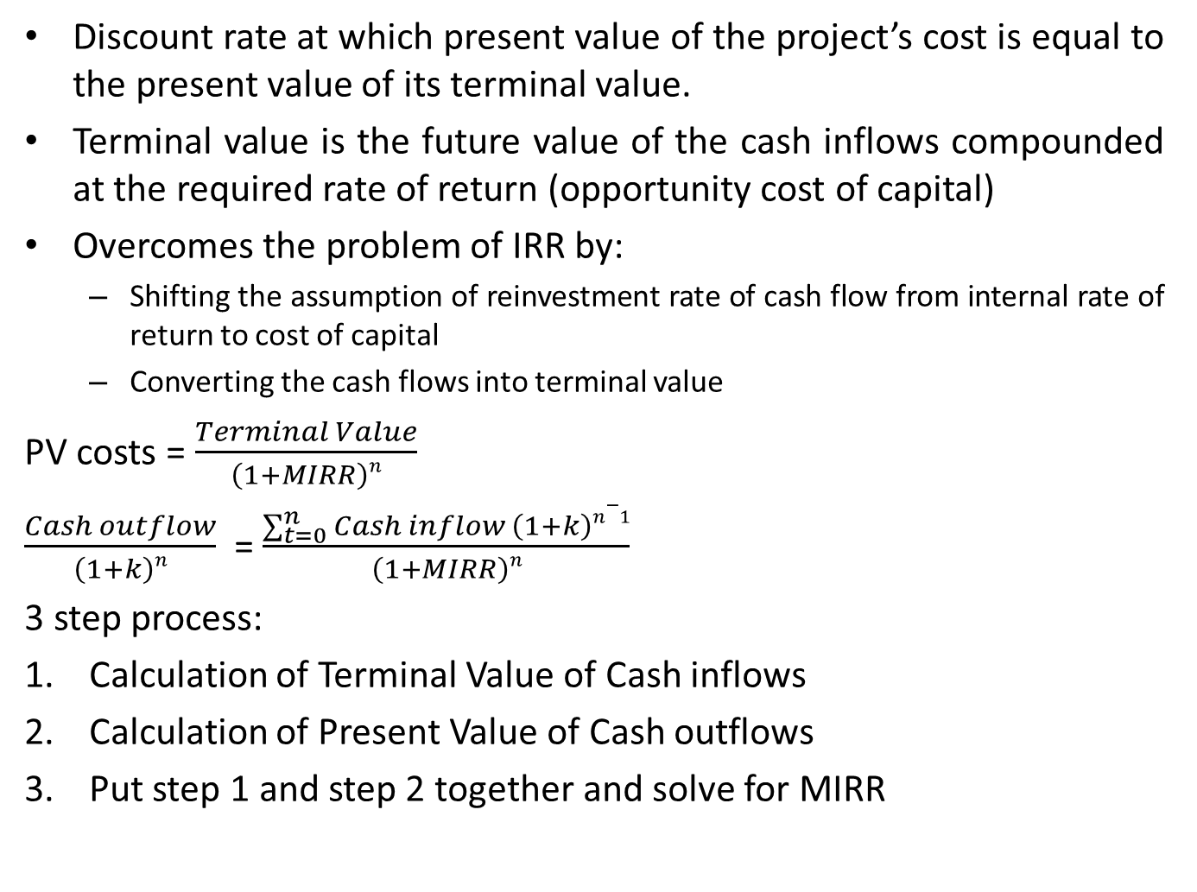
Modified Internal Rate of Return (MIRR)
Discount rate at which present value of the project’s cost is equal to the present value of its terminal value.
Terminal value is the future value of the cash inflows compounded at the required rate of return (opportunity cost of capital)
Overcomes the problem of IRR by:
Shifting the assumption of reinvestment rate of cash flow from internal rate of return to cost of capital
Converting the cash flows into terminal value
PV costs = $\frac{Terminal Value}{\left(1+MIRR\right)n}$
$\frac{Cash outflow}{\left(1+k\right)n}$ = $\frac{\sum_{t=0}^{n}{Cash inflow \left(1+k\right)n−1}}{\left(1+MIRR\right)n}$
3 step process:
Calculation of Terminal Value of Cash inflows
Calculation of Present Value of Cash outflows
Put step 1 and step 2 together and solve for MIRR

Slide 31
Modified Internal Rate of Return (MIRR)
Same as IRR i.e. if MIRR > required rate of return accept the project and if IRR < required rate of return reject the project
If mutually exclusive then one with higher IRR should be chosen
Example 6: There are two projects A and B. Each project requires an investment of Rs 100. The cost of capital is 10 percent. Net cash flows for project A and Project B are given in the following table:
Find the MIRRs for Project A and Project B
According to the MIRR, which project should be accepted if they are independent ? Mutually exclusive ?
Year | Expected net cash flows
 | Project A (in Rs) | Project B (in Rs)
0 | (100) | (100)
1 | 30 | 65
2 | 40 | 50
3 | 70 | 15

Slide 32
Merits and Demerits of MIRR
Merits:
Always gives the single correct answer
Cash flows are reinvested at cost of capital (usually WACC) rather than at same rate of project
Consider the time value of Money
Demerits:
Can lead to incorrect choice between mutually exclusive investment
Difficult to understand the calculation method of MIRR

